Slide 1




CAPSTONE PROJECT
Zomato Sales & Customer Insights Dashboard
PRESENTED BY STUDENT NAME: COLLEGE NAME:
DEPARTMENT: EMAIL ID:
SHWETANK DEV
RAJA BALWANT SINGH ENGINEERING
TECHNICAL CAMPUS ,BICHPURI ,AGRA
COMPUTER SCIENCE
shwetankdev123456789@gmail.com

Slide 2
OUTLINE:
Problem Statement (Should not include solution)
Proposed System/Solution
System Development Approach (Technology Used)
Algorithm & Deployment
Result (Output Image)
Conclusion
Future Scope
References

Slide 3
PROBLEM STATEMENT:
Managing a vast network of 150,281 services and 77,929 connections requires high-level data clarity.
It is difficult to identify which food categories (Veg vs. Non-Veg) perform better across different cities.
Tracking annual sales trends (2017–2020) is essential to understand business growth or decline.
Predicting which cities like Tirupati or Electronic City require more resources based on "Amount" and "Quantity" is a major concern.

Slide 4
PROPOSED SOLUTION:
Develop an interactive Power BI dashboard to visualize KPIs such as Total Amount ($987M$), Total Orders ($150K$), and Total Quantity ($2M$).
Implement data filtering by "Top 10," "Top 20," and "Top 100" cities to pinpoint high-value regions.
Segment food types into Veg, Non-Veg, and Others to analyze specific market demand.
Utilize time-series visualizations to monitor sales health over a four-year period.

Slide 5
System Requirements: Power BI Desktop for development and Power BI Service for sharing.
Libraries/Modules Required: Data integration of tables including food, menu, orders, restaurant, and users.
Technology: DAX (Data Analysis Expressions) for creating measures like "Amount" ($986.5M$) and "Ratings" ($148K$).

Slide 6
ALGORITHM & DEPLOYMENT:
Algorithm Selection: Use of Descriptive Analytics and Time-Series Analysis to process historical order data.
Data Input: Historical files containing order dates, city names, food categories, and customer ratings.
Training/Logic: Data modeling involves linking the Measure_Table to core data tables to ensure accurate filtering across visuals.
Deployment: The dashboard is deployed as a web-accessible report with interactive slicers for real-time data exploration.

Slide 7
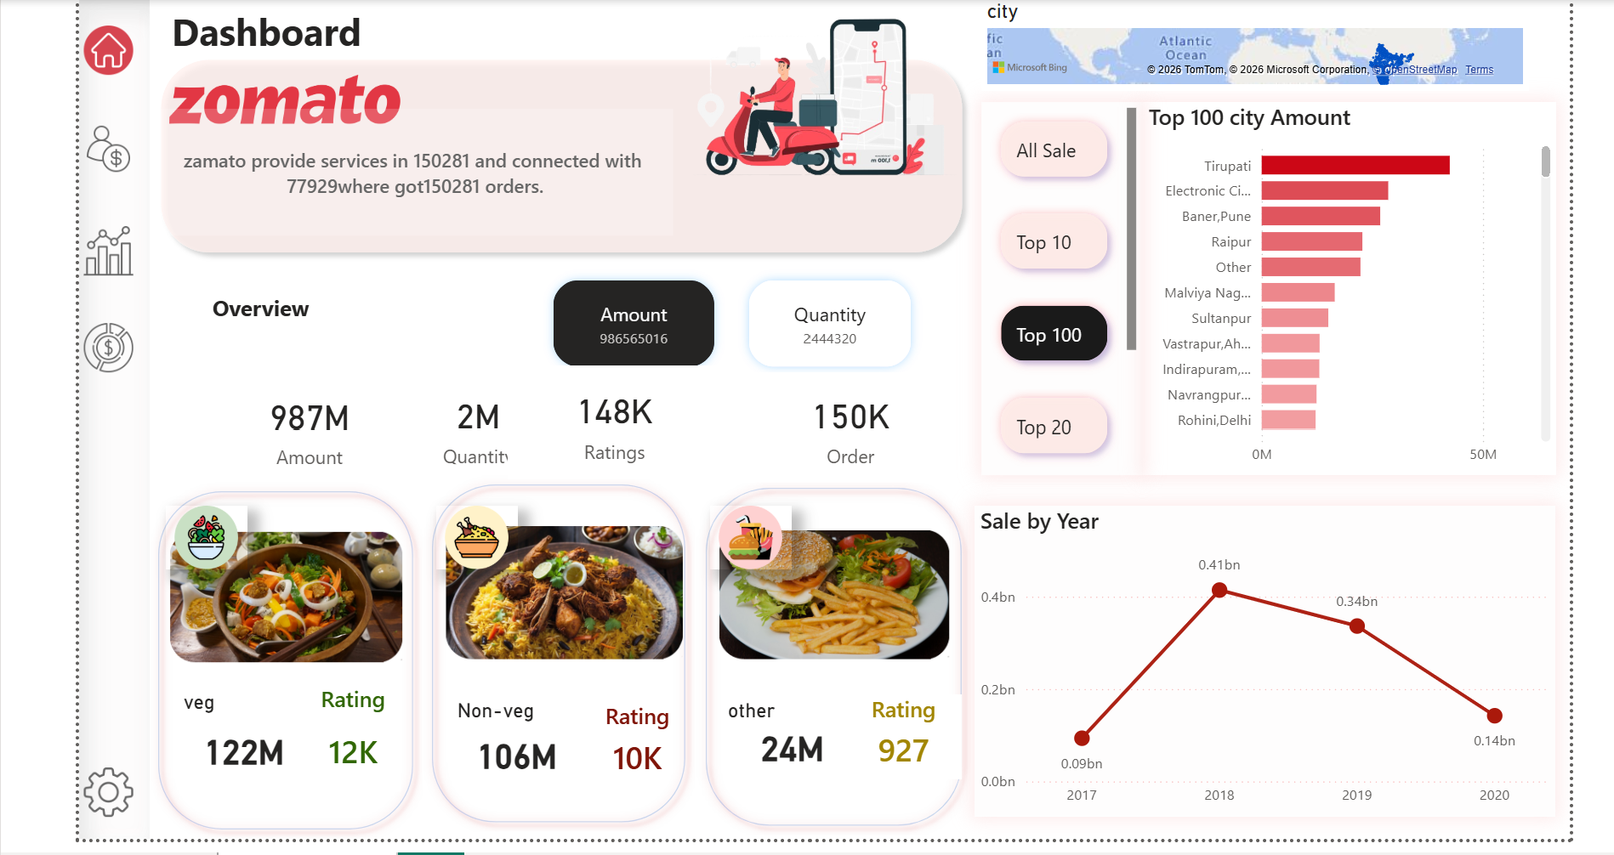
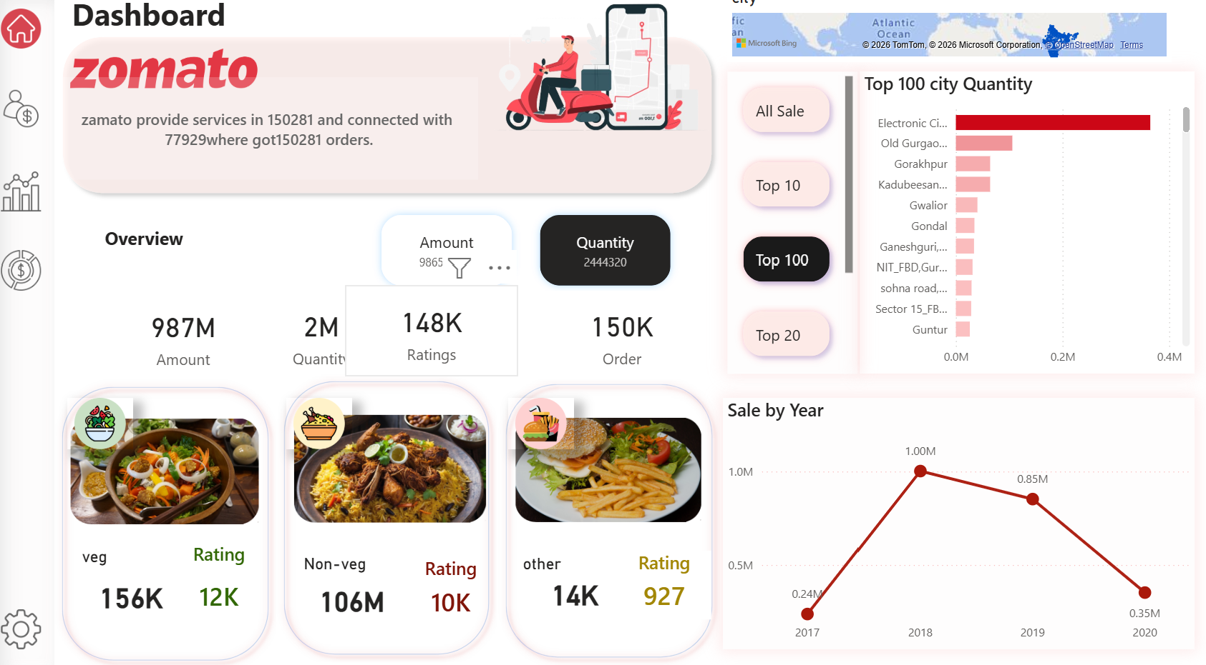
RESULT:
Key Findings: Veg food dominates with $122M$ in sales compared to Non-Veg at $106M$.
City Performance: Tirupati and Electronic City emerged as the top revenue-generating locations.
Sales Trend: Sales peaked in 2018 ($0.41bn$) before showing a downward trend towards 2020 ($0.14bn$).

Slide 8
CONCLUSION:
The dashboard successfully provides a 360-degree view of Zomato's sales performance.
Visualizing $148K$ ratings helps identify customer satisfaction levels across different segments.
Accurate data representation of the $150K$ total orders is crucial for ensuring a stable delivery supply chain in urban areas.

Slide 9
FUTURE SCOPE:
Integration of real-time delivery tracking and predictive demand forecasting using Machine Learning.
Expanding the dashboard to include sentiment analysis of customer reviews from the "ratings" data.
Incorporating external data like weather or local events to see their impact on "Sale by Year".

Slide 10
REFERENCES:
Microsoft Elevate AICTE Internship Guidelines.
Zomato Dataset for Business Intelligence Analysis.
Power BI Documentation for DAX and Data Modeling.

Slide 11
Thank You

